Slide 1


Automobile Maintenance App
By Team 2
Aliza Levinger
Tianyu Li
Brenden O’Reilly

Slide 2

Do Americans Love Their Automobiles?
Let’s find out.

Slide 3

Passenger Vehicles in the U.S.
more passenger vehicle than any other country.
354 million passenger vehicle.
More than one automobile for each person able to drive
Growing steadily since 1960.

Slide 4






New Cars Sold Each Year
12.8 million new cars sold in the U.S. in 2011, with an average price of $30,300.

Slide 5

U.S. Automotive Aftermarket
Estimated to be worth 318 billion.
Contributes 2.3 % of GDP
Employs 4.2 million people.

Slide 6

Auto Repair Shops
Almost 160,000 automobile repair shops employing 650,000 people, according to Auto Shop Online.
Average auto repair bill on the rise

Slide 7
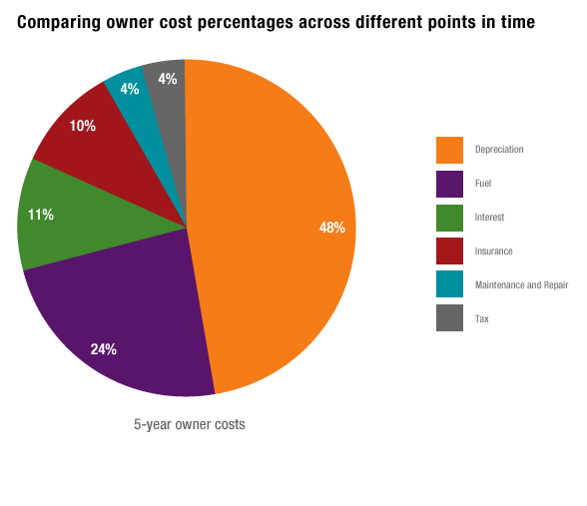
But Cars Are Expensive

Slide 8

App Demographic
Huge Demographic
Basically anyone that wished to keep their automobile in good working order, and wishes to save money on repair bills.

Slide 9
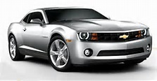
Typical User
Mike is a hypothetical car owner. He is proud of this 2010 Chevy Comaro and wants to keep it in perfect running order. He would also like to save as much as possible on his auto repair bills.

Slide 10

Competitors
aCar
Car Maintenance Reminder Lite
CarPros – Car Management
Carango – Car Management
Vehi Car – Car Maintenance

Slide 11

How Our App is Better
There are several apps in the Pay Store that provide similar features. Automobile Maintenance App will provide many of the features of these competitor apps with a better user interface.

Slide 12
Features
Register your vehicle information, as well as its image.
Track vehicle maintenance.
Setup reminders for upcoming suggested service appointments.
Quick dialing feature to his mechanic, in case of emergencies.

